Slide 1
Responsive Websites for a better User Experience
Responsive Website Layout with media query

Slide 2
Viewport Meta Tag
Add the following meta tag to the head section of your HTML page
<meta name="viewport" content="width=device-width, initial-scale=1, shrink-to-fit=no">

Slide 3
<meta name="viewport" content="width=device-width, initial-scale=1.0">
This gives the browser instructions on how to control the page's dimensions and scaling.
The width=device-width part sets the width of the page to follow the screen-width of the device (which will vary depending on the device).
The initial-scale=1.0 part sets the initial zoom level when the page is first loaded by the browser.

Slide 4
Responsive Design: Introduction
Before mobile phones and other smart devices became common, websites were accessed through desktop computers and then Laptops.
Same resolution across all computers hence websites had fixed widths. These were built using tables, fixed-width, divs, or other static layouts.
This in turn introduced Sideways scrolling which is not as convenient as vertical scrolling.
While it worked then there are certain limitation to website design and they include:
  Lack of adaptability: These layouts do not automatically adjust to different screen sizes or devices.
  Inefficient use of space: Content might be squeezed or stretched, leading to readability issues
  Difficulty in maintenance: Changing the layout requires modifying multiple elements throughout the codebase.

Slide 5
MEDIA QUERIES
The CSS @media rule, allows us to define different style rules for different media types and/or different screen sizes.

Slide 6
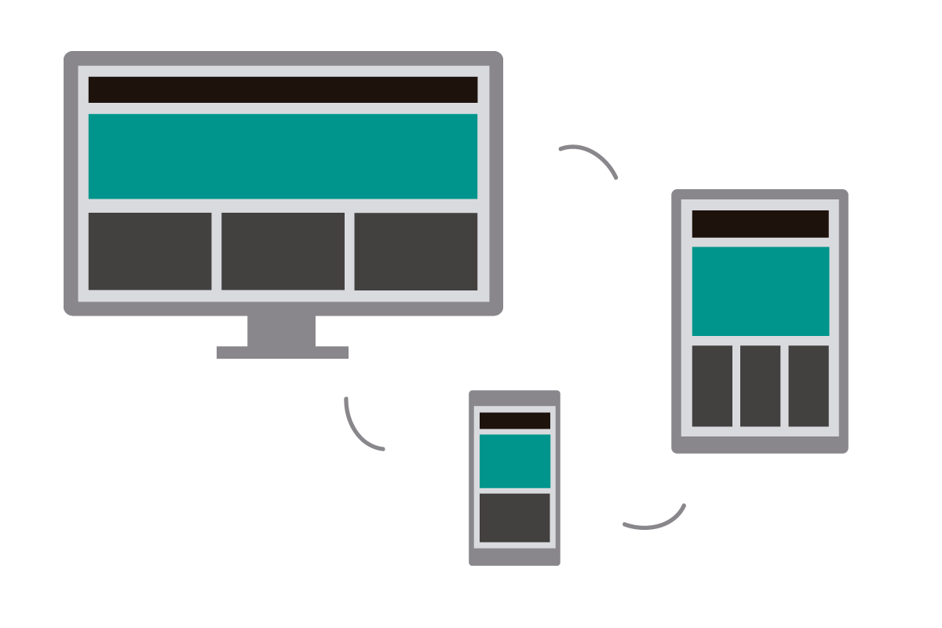
The same website looks different across various devices

Slide 7
INTRODUCTION
CSS Media queries are a way to target browsers by certain characteristics, features, and user preferences, then apply styles or run other code based on those things
Media queries are rules used to override the initial CSS rules of elements, in order to achieve responsive layout across different screen sizes.
CSS media queries allow you to define CSS rules that only apply when certain conditions are met.
These conditions are based on the characteristics of the device, such as screen size, resolution, orientation, and more.

Slide 8
@media query Syntax
@media mediatype and (expressions) {
CSS-Code;
/*That is, CSS declarations*/
}
NOTE: mediatype may be: all, print, screen
Usage:
@media screen and (min-width: 480px) {
body {
background-color: lightgreen;
}
}
The mediatype is used to specify when the rule should be applied. For example, print means that the rule should only apply when the page in question is being printed; the output from the printer

Slide 9
You can use media queries to change the font size of an element on different screen sizes:
For example, if screen size is more than 600px wide, set the font-size of <div> to 80px
You can also use the (max-width: ..) and (min-width: ..) values to set a minimum width and a maximum width as follows:
@media screen and (max-width: 900px) and (min-width: 600px) {
      div {font-size:80px;}
  }
You can specify a different height when the screen size is smaller. Etc

Slide 10
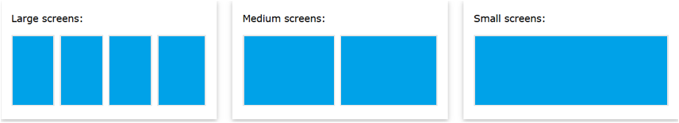
A common use of media queries, is to create a flexible [responsive] layout when the screen size varies as shown in the image below:
.parent { display: flex; }
.child{ width: 25%;}
See Notes for more

Slide 11
PRINCIPLES
We don’t have to write media query rules for all our css, to achieve responsiveness, focus on the key principles below:
Avoid setting dimension/size, write media query for things that may affect your page layout such as:
  Rigid Images and Media: use % to scale where necessary
  Rigid Typography: use relative units like percentages or em to set font sizes, and use media queries to adjust them based on the screen size.
Testing your web site on different screen sizes.

Slide 12
Media Query BreakPoints
Devices are generally categorized into the following breakpoints: - 1280, 1024, 768, 480
  1280-1024 - desktop (default grid)
  1024-768 - tablet landscape
  768-480 - tablet
  480-less - phone landscape & smaller devices
  Breakpoints shows at what point the device layout will change in order to fit the screen for better user experience

Slide 13
Understanding Media Query: Hide elements on different screen sizes
<style>
div.example {
background-color: yellow;
padding: 20px;
}
@media screen and (max-width: 600px) {
div.example {
display: none;
}
}
</style>
<!DOCTYPE html>
<html>
<head>
</head>
<body>
<h2>Hide elements on different screen sizes</h2>
<div class="example">Example DIV.</div>
<p>When the browser's width is 600px wide or less, hide the div element. Resize the browser window to see the effect.</p>
</body>
</html>

Slide 14
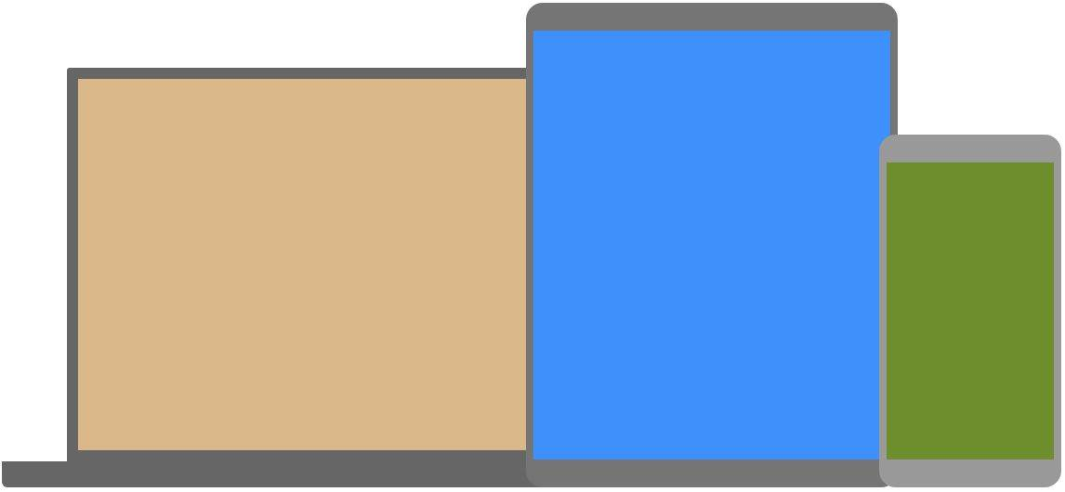
Class Exercise: How can you achieve this, such that as the screen gets smaller, the webpage background-color changes

Slide 15
CSS ICONS

Slide 16
Font Awesome Icons
To use the Font Awesome icons, go to https://fontawesome.com/icons, sign in, and get a code to add in the <head> section of your HTML page:
<script src="https://kit.fontawesome.com/yourcode.js" crossorigin="anonymous"></script>

Slide 17
Bootstrap icons
High quality, open source icon library with over 2,000 icons. Include them anyway you like—SVGs, SVG sprite, or web fonts. Use them with or without Bootstrap in any project.
CDN
Include the icon fonts stylesheet—in your website <head> or via @import in CSS—from jsDelivr and get started in seconds. See icon font docs for examples.
<link rel="stylesheet" href="https://cdn.jsdelivr.net/npm/bootstrap-icons@1.13.1/font/bootstrap-icons.min.css">

Slide 18
Icons8.com
This does not require CDN. To use, visit https://icons8.com/icons

Slide 19
CSS animate

Slide 20
Animation
Several CSS libraries to get animation in your HTML/CSS project code. One of such free open source animation site is
https://animate.style
NOTE: Kindly read through the document and see other ways to use the css animation to apply other styles.

Slide 21
CSS GRID
The CSS Grid Layout Module offers a grid-based layout system, with rows and columns, making it easier to design web pages without having to use floats and positioning
                div.container {
                display: grid;
                grid-template-columns: auto auto;
                };

Slide 22
CSS Grid Components
A grid always consists of:
A Grid Container - The parent (container) element, where the display property is set to grid or inline-grid
One or more Grid Items - The direct children of the grid container automatically becomes grid items
Grid Layout
A Grid Layout must have a parent element with the display property set to grid or inline-grid.
Direct child element(s) of the grid container automatically becomes grid items.

Slide 23
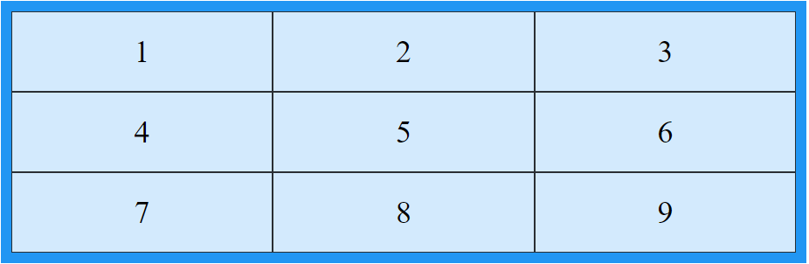
.grid-item {
background-color: rgba(255, 255, 255, 0.8);
border: 1px solid rgba(0, 0, 0, 0.8);
padding: 20px;
font-size: 30px;
text-align: center;
}
.grid-container {
display: grid;
grid-template-columns: auto auto auto;
background-color: #2196F3;
padding: 10px;
}

Slide 24
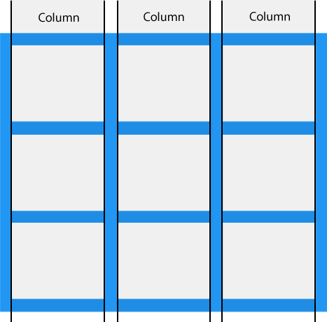
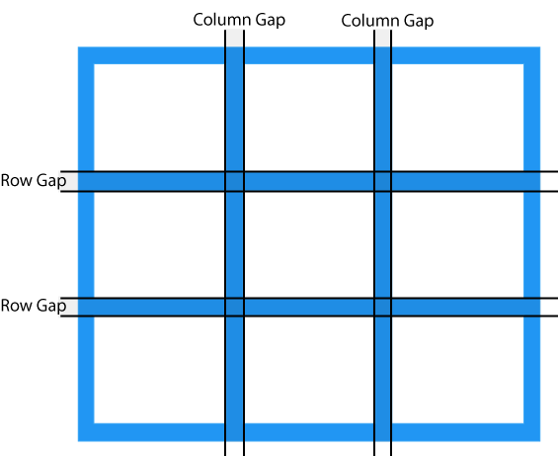
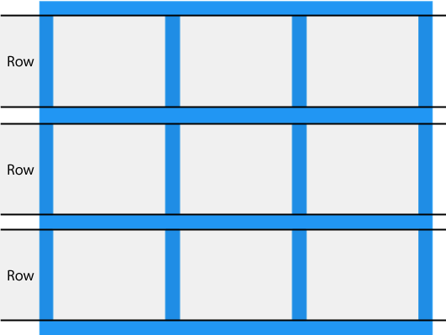
Grid Columns and Grid Rows
The vertical lines of grid items are called columns.
The horizontal lines of grid items are called rows.
The spaces between each column/row are called gaps.

Slide 25
Using Gaps
You can adjust the gap size by using any of the followings properties set to the grid container.
Column-gap
Row-gap
Gap.
All values set in pixels (E.g., 50px).
While column-gap sets the gap between the columns, and row-gap set the gap between the rows, gap is a shorthand for setting both.
Grid Lines
The lines between columns are called column lines.
The lines between rows are called row lines.
.item1 {
grid-column-start: 2;
grid-column-end: 4;
}
.item1 {
grid-row-start: 1;
grid-row-end: 3;
}

Slide 26
CSS Grid Container
To make an HTML element behave as a grid container, you have to set the display property to grid or inline-grid. Grid containers consist of grid items, placed inside columns and rows.
The grid-template-columns Property
The grid-template-columns property defines the number of columns in your grid layout, and it can define the width of each column.
If you want your grid layout to contain 4 columns, specify the width of the 4 columns using % or px, or "auto" if all columns should have the same width.
Note: If you have more than 4 items in a 4 columns grid, the grid will automatically add a new row to put the items in.

Slide 27
The grid-template-columns property can also be used to specify the size (width) of the columns.
.grid-container {
display: grid;
grid-template-columns: 80px 200px auto 40px;
}
Using auto values
.grid-container {
display: grid;
grid-template-columns: auto auto auto auto;
gap: 10px;
background-color: #2196F3;
padding: 10px;
}

Slide 28
The grid-template-rows Property
The grid-template-rows property defines the height of each row. The value is a space-separated-list, where each value defines the height of the respective row:
.grid-container {
display: grid;
grid-template-columns: auto auto auto;
grid-template-rows: 80px 200px;
gap: 10px;
background-color: #2196F3;
padding: 10px;
}
The justify-content Property and the align-content property
We can also use these properties to control the layout of our grid setting values such as: end, start, space-evenly, space-around, space-between, and center.

Slide 29
Child Elements (Grid Items)
A grid container contains grid items.
By default, a container has one grid item for each column, in each row, but you can style the grid items so that they will span multiple columns and/or rows.
The grid-column Property:
The grid-column property defines on which column(s) to place an item.
You define where the item will start, and where the item will end.
Note: The grid-column property is a shorthand property for the grid-column-start and the grid-column-end properties.
.item1 {
grid-column: 1 / 5;
}
.item1 {
grid-column: 1 / span 3;
}

Slide 30
The grid-row Property:
The grid-row property defines on which row to place an item.
You define where the item will start, and where the item will end.
Note: The grid-row property is a shorthand property for the grid-row-start and the grid-row-end properties.
To place an item, you can refer to line numbers, or use the keyword "span" to define how many rows the item will span:
.item1 {
grid-row: 1 / 4;
}
.item1 {
grid-row: 1 / span 2;
}

Slide 31
CSS
GRADIENT PROPERTY

Slide 32

Color Gradients in CSS
In place of a background image, CSS gradients let you display smooth transitions between two or more specified colors.
CSS defines the following gradients:
Linear Gradients (goes down/up/left/right)
Radial Gradients (defined by their center)
Conic Gradients (rotate around a center point)

Slide 33
LINEAR GRADIENT
To create a linear gradient you must define at least two color stops. Color stops are the colors you want to render smooth transitions among. You can also set a starting point and a direction (or an angle) along with the gradient effect.
Syntax:
background: linear-gradient(direction, color-stop1, color-stop2, ...);
Example:
#grad {
background: linear-gradient(to left, red , yellow); /*left to right*/
}
background-image: : linear-gradient(to bottom right, red, yellow); /*diagonal*/
background-image: : linear-gradient(45deg, red, yellow); /*Using angle*/
background-image: : linear-gradient(to right, rgba(255,0,0,0), rgba(255,0,0,1)); /*transparent colors*/
background-image: repeating-linear-gradient(45deg,red,yellow 7%,green 10%);

Slide 34
Adding Linear Gradient to Background-Image
To add a semi opaque/semi transparent colour gradient that goes on top of the background image, you need not introduce a second div. Simply add linear gradient to the same div carrying the background image as follows:
A simpler method is to use background image with gradient.
#banner{
background-image:
linear-gradient(to bottom, rgba(0,0,0, 0.52),
rgba(10,10,30, 0.73)),
url('banner.jpg');
height: 300px;
background-size: cover;
}

Slide 35
RADIAL GRADIENT
To create a radial gradient you must define at least two color stops. Unlike the linear gradient, the radial gradient is defined by its center.
Syntax:
background: radial-gradient(shape, color1 N%, color2 Y%,...)
Example:
#radial {
background-image: radial-gradient(red, yellow, green);
}
#radial {
background-image: radial-gradient(red 5%, yellow 15%, green 60%);
}
#adial {
background-image: radial-gradient(circle, red, yellow, green);
}

Slide 36
CONIC GRADIENT
A conic gradient is a gradient with color transitions rotated around a center point. To create a conic gradient you must define at least two colors.
Syntax:
background: conic-gradient([from angle] [at position,] color [degree], color [degree], ...);
Example:
#conic {
background-image: conic-gradient(red, yellow, green);
}
#conic {
background-image: conic-gradient(red 45deg, yellow 90deg, green 210deg);
}

Slide 37
Using online background
https://www.transparenttextures.com/
https://pattern.monster/

